Slide 1


SmartHealth
Insurance
Management System
-Rishika Cheeti

Slide 2
Project Overview
Objective:
To streamline the entire health insurance lifecycle from policy enrollment and premium payments to claims processing and hospital treatment verification through a unified, role-based digital platform.
Technology Stack:
ASP.NET Core 8 Web API, Angular 21, SQL Server.

Slide 3
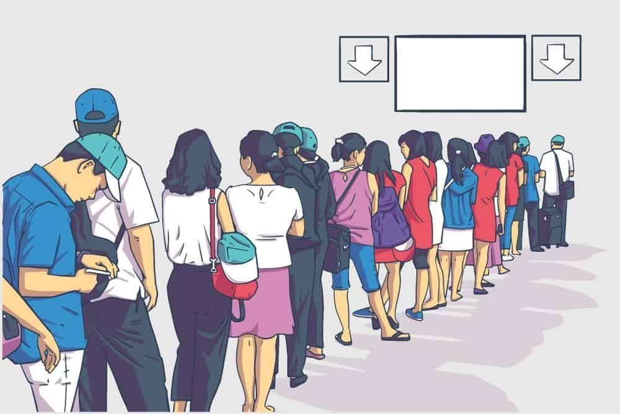
Problem Statement
Current health insurance systems are slow and confusing because they rely heavily on manual paperwork and disconnected processes. This leads to long delays in claim approvals, frequent errors in payments, and frustration for customers who cannot easily
track their status. There is a critical need for a unified digital platform that connects customers, hospitals, and insurers in real-time to make insurance management faster, transparent, and error-free.

Slide 4

Solution & Key Features
Unified Digital Platform: Connects customers, hospitals, and insurers on a single, seamless ecosystem.
Role-Based Access Control: Delivers secure, personalized dashboards tailored to each user's specific role.
Automated Policy Management: Simplifies enrollment and renewals while enabling instant coverage verification.
End-to-End Claims Workflow: Digitizes the entire claims process for transparency and faster approvals.
Real-Time Analytics: Empowers decision-makers with instant visibility into financial performance and claim trends.

Slide 5
Technology Stack
Built with ASP.NET Core 8 Web API, utilizing Entity Framework Core for robust data management and JWT for secure, stateless authentication.
Developed using Angular 17 with TypeScript, featuring a responsive UI built with Angular Material and Bootstrap for a seamless user experience across devices.
Implements granular Role-Based Access Control (RBAC) for Admins, Customers, Agents, Claims Officers, and Hospital Managers to ensure data security
Powered by Microsoft SQL Server for high-performance, relational data storage, managed via Entity Framework Core Code-First migrations

Slide 6
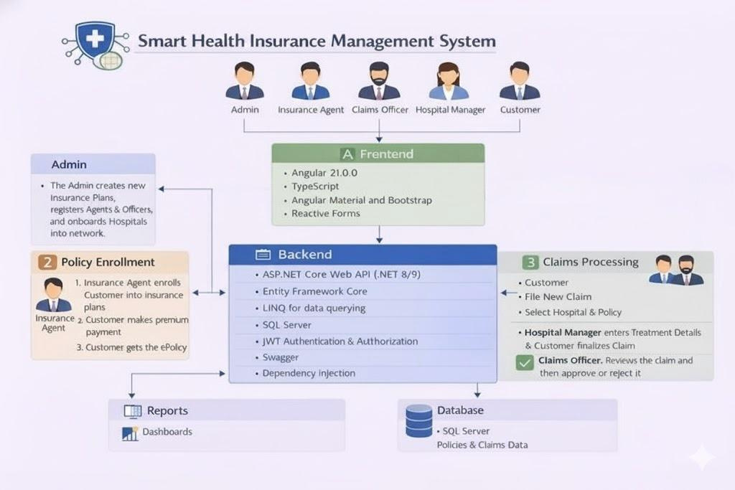
System Architecture

Slide 7
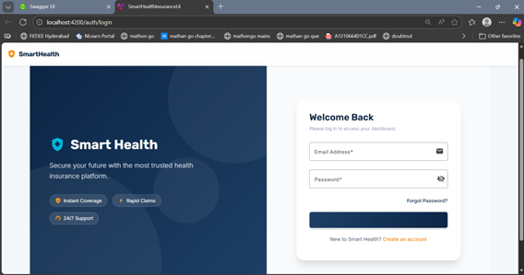
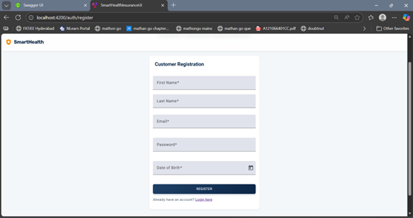
Dashboard Screen
Login Page
Register page for Customer

Slide 8
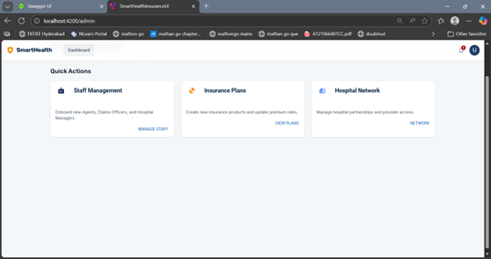
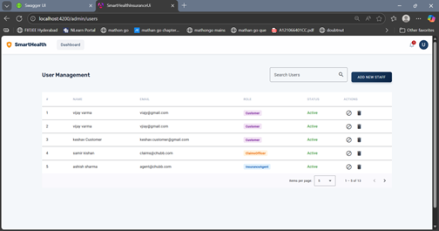
Admin Dashboard
User management

Slide 9
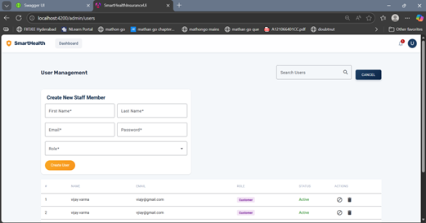
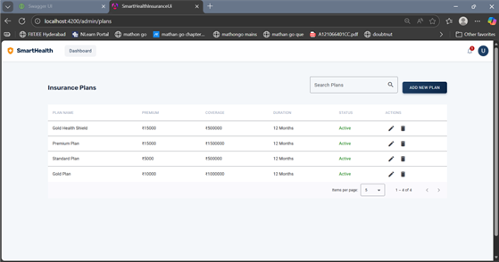
Admin can add staff
List of Insurance plans created

Slide 10
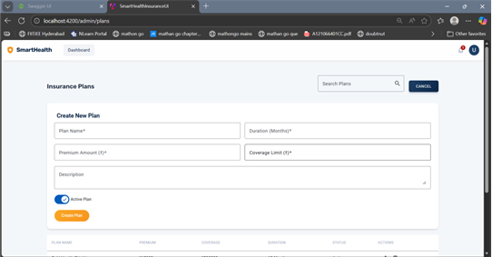
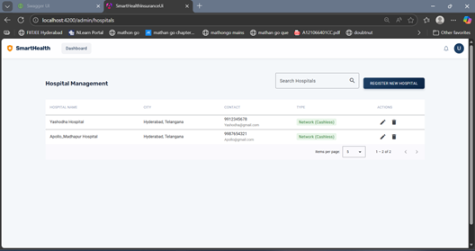
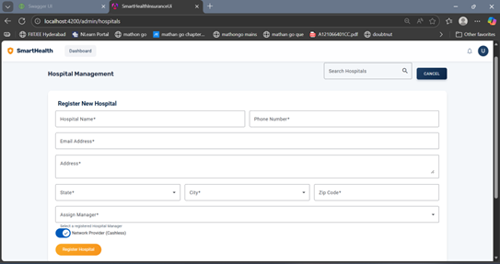
Admin can create new Insurance plan
Hospital Management page

Slide 11
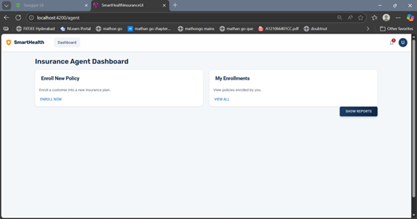
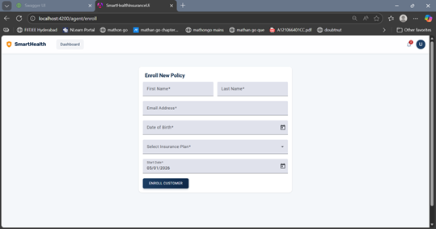
Insurance agent dashboard
Agent can enroll policy to a customer

Slide 12
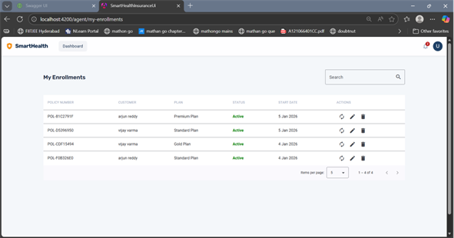
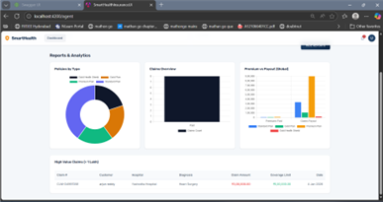
List of enrollments done by Agent
Reports and analytics for
agent dashboard

Slide 13
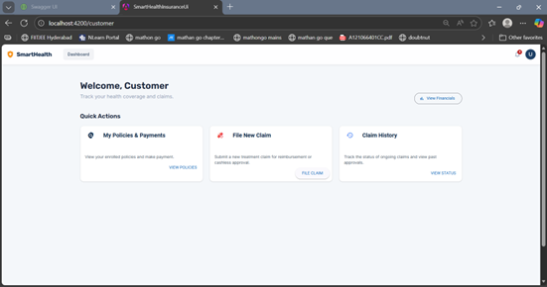
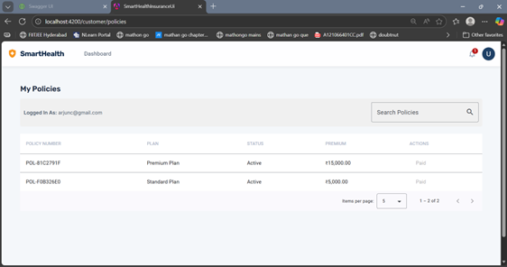
Customer Dashboard
Customer policies page

Slide 14
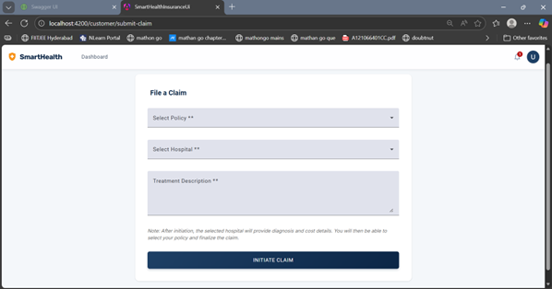
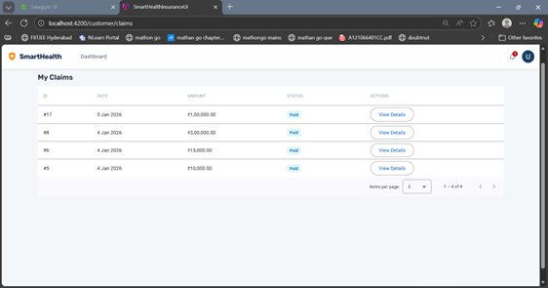
Claims filing page
Claims raised by customer

Slide 15
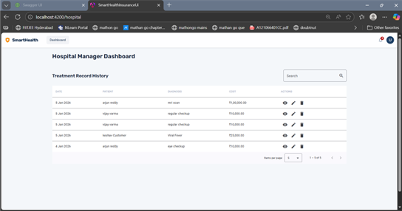
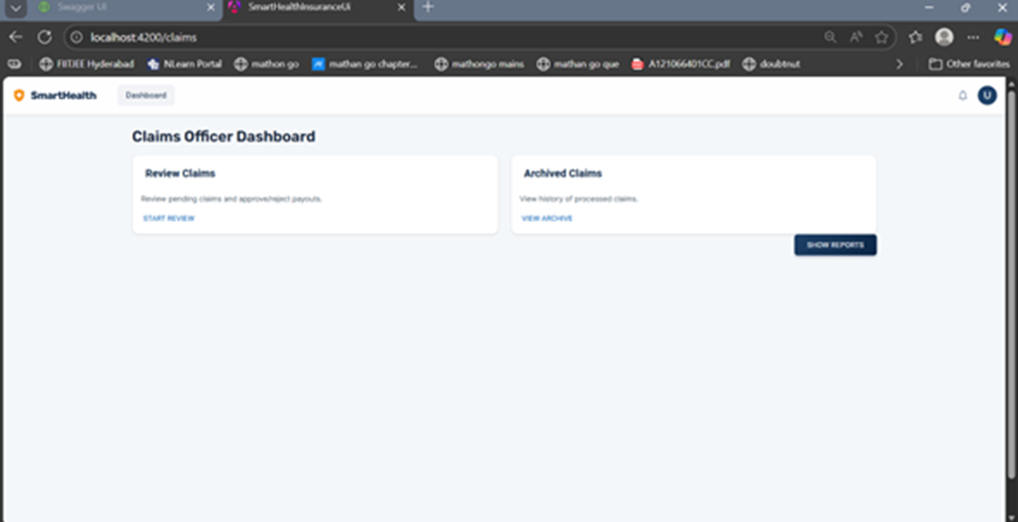
Hospital Manager dashboard
Claims officer dashboard

Slide 16
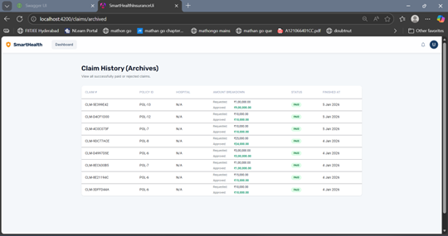
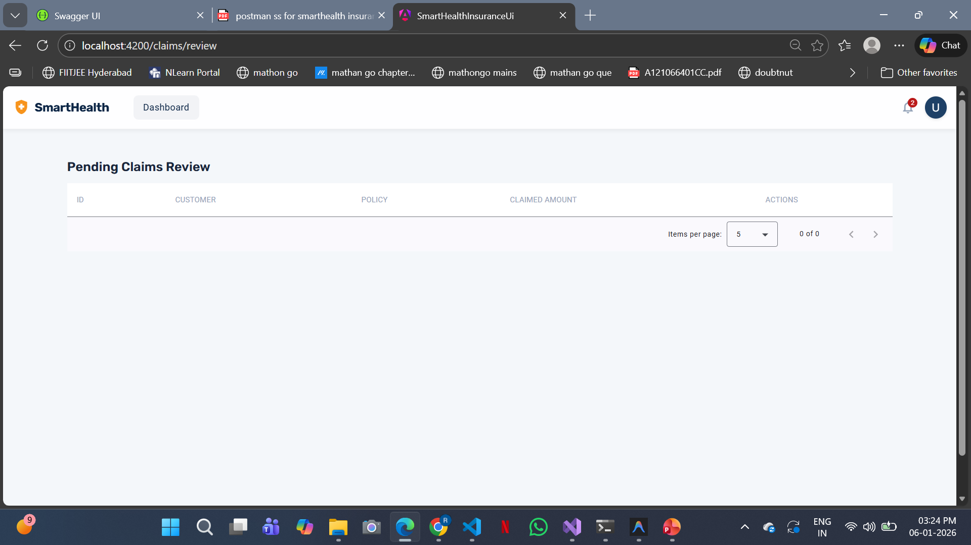
Claims History
Pending Claims

Slide 17
Results & Achievements
End-to-End Automation: Developed a complete digital ecosystem that automates the entire insurance lifecycle from policy issuance and hospital treatment verification to claim review and final payout.
Robust Full-Stack Architecture: Built a secure and scalable system using .NET Core 8 and Angular, implementing Clean Architecture and Role-Based Access Control (RBAC) for data security.
Performance & Usability: Delivered a responsive user experience with advanced features like server-side pagination, real-time analytics dashboards, and seamless search capabilities for handling large datasets.

Slide 18
LIVE
DEMONSTRATION

